Slide 1

Cluster computing: Chapel vs Mpi
Mac Lyle
Advisors: John Dougherty and Dave Wonnacott

Slide 2
Literature Review
Gustafson’s speed-up
Novel methods for batch scheduling
Dynamically sizing parallel applications
Kremer Herman “right-sizing” applications [1]
Increasing throughput of applications on clusters
Notes:
Parallel computing is really important especially in scientific research since it allows you to compute huge amounts of data much faster than you would in serial. This speed up is formally defined by Gustafson’s Law which I won’t go into in detail for the sake of time. But the idea is that as you are able to compute more things at the same time (so in parallel) you can get more done within in a given period of time.
My lit review analyzed and reviewed novel methods for increasing throughput of parallel jobs on computing clusters. These methods mainly focused on scheduling optimization and dynamically growing or shrinking parallel computing applications.

Slide 3
Question:
Does Chapel provide researchers the tools to complete their parallel computing needs faster?
Notes:
However, I specifically wanted to look into the programming side of parallel computing. So I analyzed two different ways to parallelize an application. One being Chapel and the other the current industry standard, MPI. I was trying to answer the question: Does Chapel provide researchers the tools to complete their parallel computing needs faster?

Slide 4
Motivation
Experience tools available to researchers for scientific computing
Test accessibility
Compare performance
Determine trade-offs
Usability vs. Execution Time
Notes:
To answer this question I had to experience both MPI and Chapel and document the potential trade offs between performance and usability.
You may have heard about this type of trade off in programming with the language Python. Python may not be the fastest language to execute but since it’s so easy to write in, development goes quicker. Thus overall time to getting an answer is shorter.

Slide 5
Background
What is Chapel?
Language from Cray Inc.
Easy to use
High levels of abstraction
What is MPI?
Message Passing Interface
Standardized library for C and Fortran
Notes:
So what are Chapel and MPI? Chapel is a language created by Cray which is a company specializing in supercomputing. Chapel was created with the goal of being essentially the Python of parallel computing. Easy to use with high levels of abstraction making it easy for humans to read and understand.
On the other hand, MPI which stands for Message Passing Interface is the current standard for running applications in parallel. MPI not actually language rather a standardized library of functions for the languages C and Fortran. Needless to say, C and Fortran are a bit harder to use than something like Python and are thus less accessible.

Slide 6
Method
Create equivalent programs in MPI and Chapel
Single machine multi-core
Multi-machine single core
Multi-machine multi-core
Execute performance runs and record timings
Analyze results
Notes:
The method that I used to compare MPI and Chapel was first to create equivalent program in both implementations. I then adapted these programs to be able to scale to different levels of parallel. Firstly be able to run on a single machine using multiple cores at once. Then multiple machines using a single core each and finally multiple machines using multiple cores at once.
I should note at this point that due to some limitations of the Haverford Lab I was only able to get MPI running on the single machine multiple core version. Chapel I was able to run all three.
I then executed performance runs and recorded and analyzed the results.

Slide 7
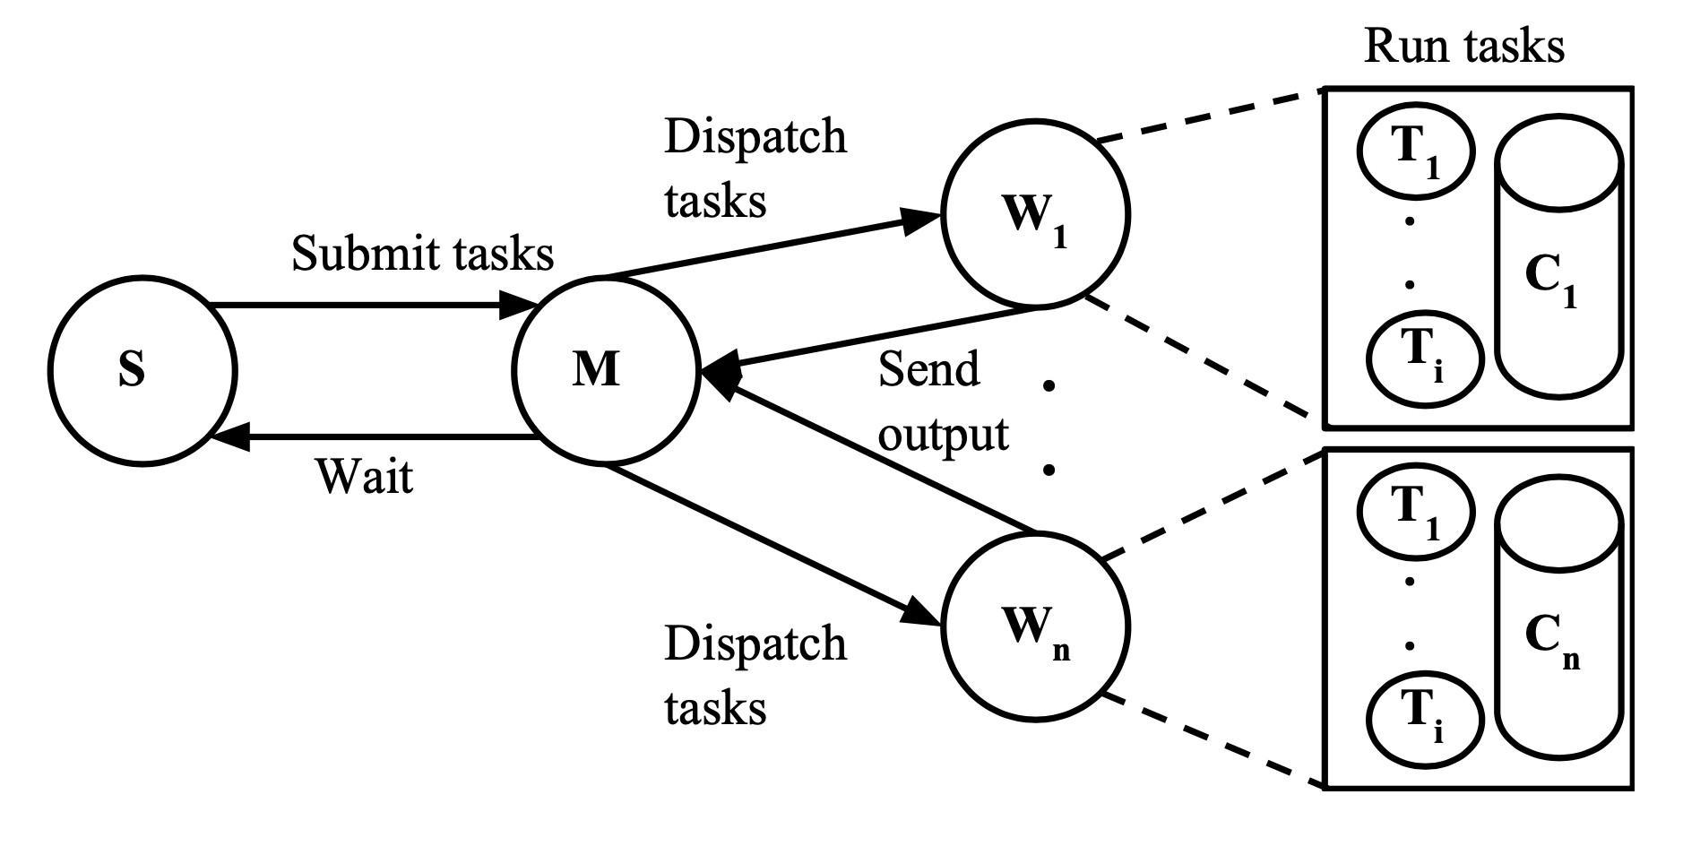

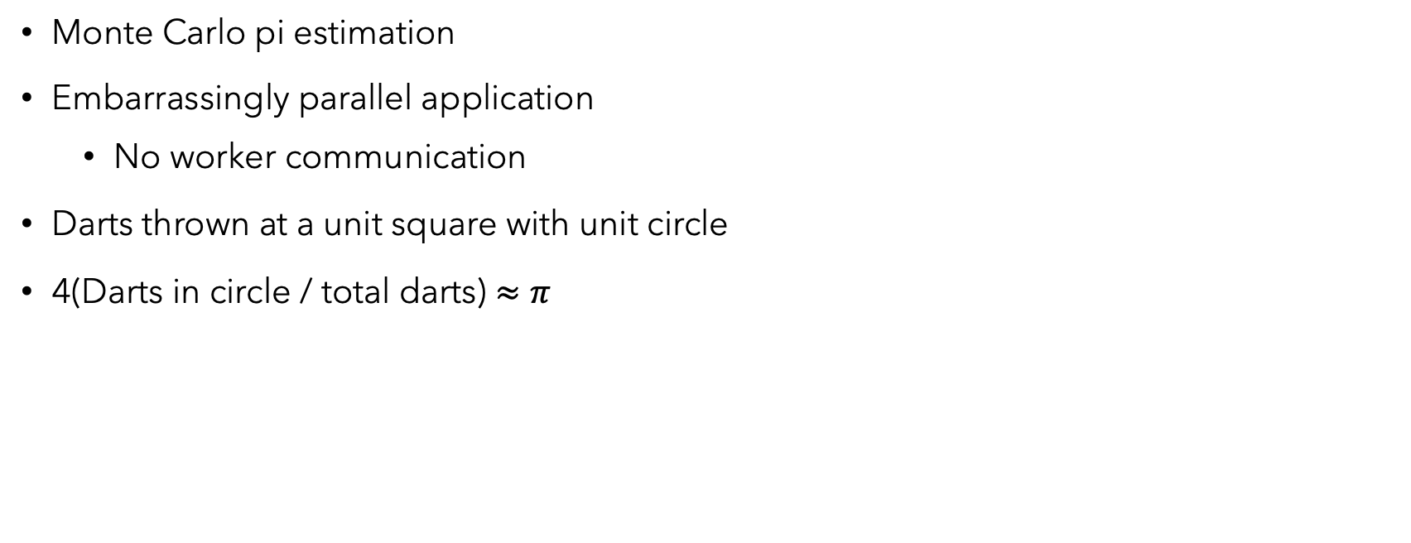
The Program
[1]
Monte Carlo pi estimation
Embarrassingly parallel application
No worker communication
Darts thrown at a unit square with unit circle
4(Darts in circle / total darts) $≈π$
[2]
Notes:
The program that I decided to write was a Monte Carlo pi estimation. This utilized a master worker architecture which is shown at the top right of the slide. This architecture is very simple. The master is responsible for sending out work and compiling answers received from the workers and the workers simply execute the tasks they are given and return it to the master.
This application is also called embarrassingly parallel since the workers do not need to communicate with each other in order to complete their task. This should be the fastest type of parallel program since communication is relatively slow.
To estimate pi, there is a “dart board” which is a unit square containing a unit circle and “darts” are thrown at the board. That is random points in the square are generated. The total darts in the circle divided by the total number of darts thrown multiplied by four is approximately pi.

Slide 8
Parallel Code Sample From Pi estimation
// In MPI C (82 lines total)
MPI_Init(&argc, &argv); MPI_Comm_size(MPI_COMM_WORLD, &numProcs); MPI_Comm_rank(MPI_COMM_WORLD, &myRank);
// Do stuff
MPI_Finalize();
// In Chapel (38 lines total)
coforall loc in Locales with (ref finalInCircle) {
on loc {
// Do stuff
}
}
Notes:
Here is what I think is the most important part of the code. How each implementation goes parallel. In MPI the INIT function initializes all the workers and the comm size and rank give the size of the work and the essentially id of the worker. Finalize frees all the workers and space used. In Chapel a simple for loop is used where locales are the number of machines. The ref to finalInCircle is a pointer to a shared location where workers will put their answers. Both receive the number of nodes to spin up from the command line.
I left reduce code out as it is more specific to the unique applications themselves and not how each implementation actually runs in parallel.
I’ll also note here that the full code for the MPI application in C was 82 lines while the Chapel version was only 38. Chapel being about half the size of the MPI code speaks to the higher level of abstraction and accessibility of Chapel vs MPI.

Slide 9
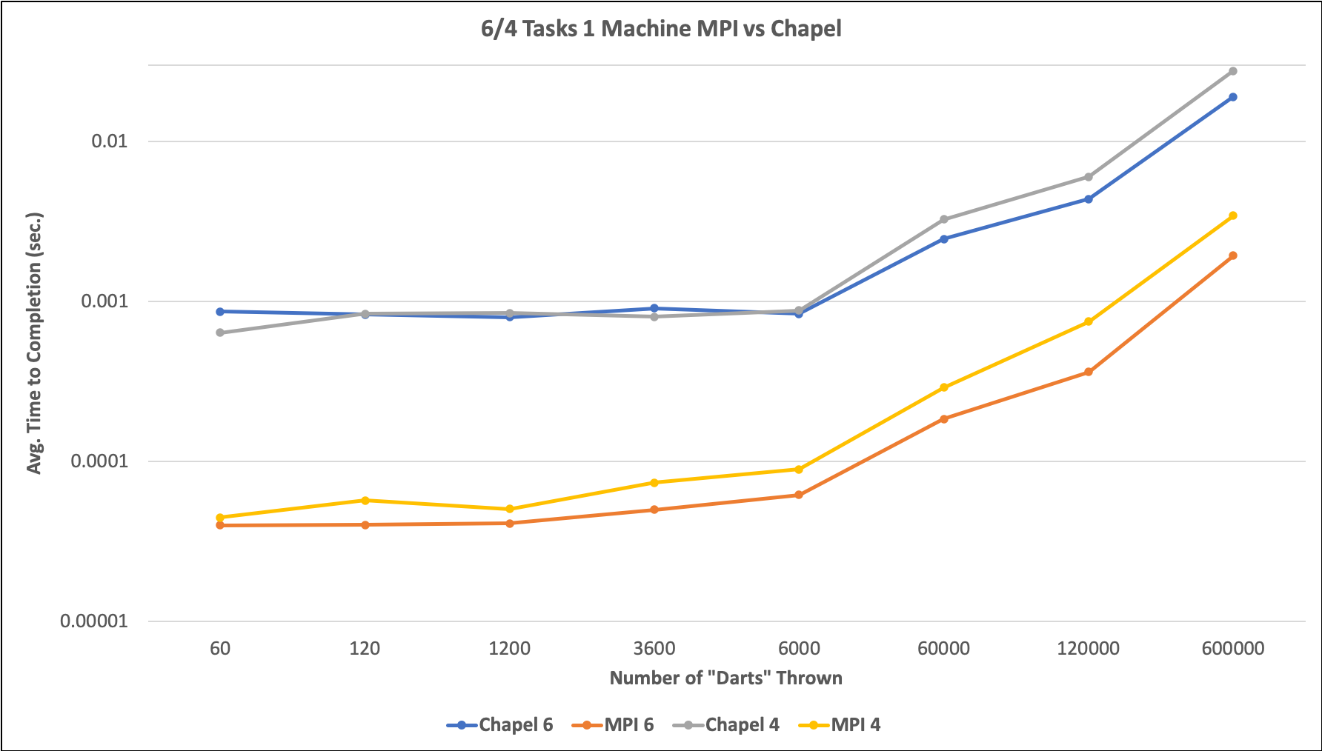
results
Notes:
This graph shows the results of only performance comparison I was able to run between MPI and Chapel. That is running multiple tasks on a single machine. The machine with the most usable cores that I could find in the Haverford labs had 6 thus the 6 tasks. This means the total number of operations was divided by 6 and distributed across the 6 cores of the single machine. I also ran this experiment on the same machine but utilizing only 4 cores.
MPI is in red and orange and Chapel in Blue and grey. First looking at each implementation we can see that the 6 core timings were faster than the four cores especially at scale with the exception of Chapel 6 core being slower than 4 core on the 60 dart test. This is likely due to the overhead of creating workers. It’s also very apparent that Chapel is significantly slower than MPI in all cases.

Slide 10
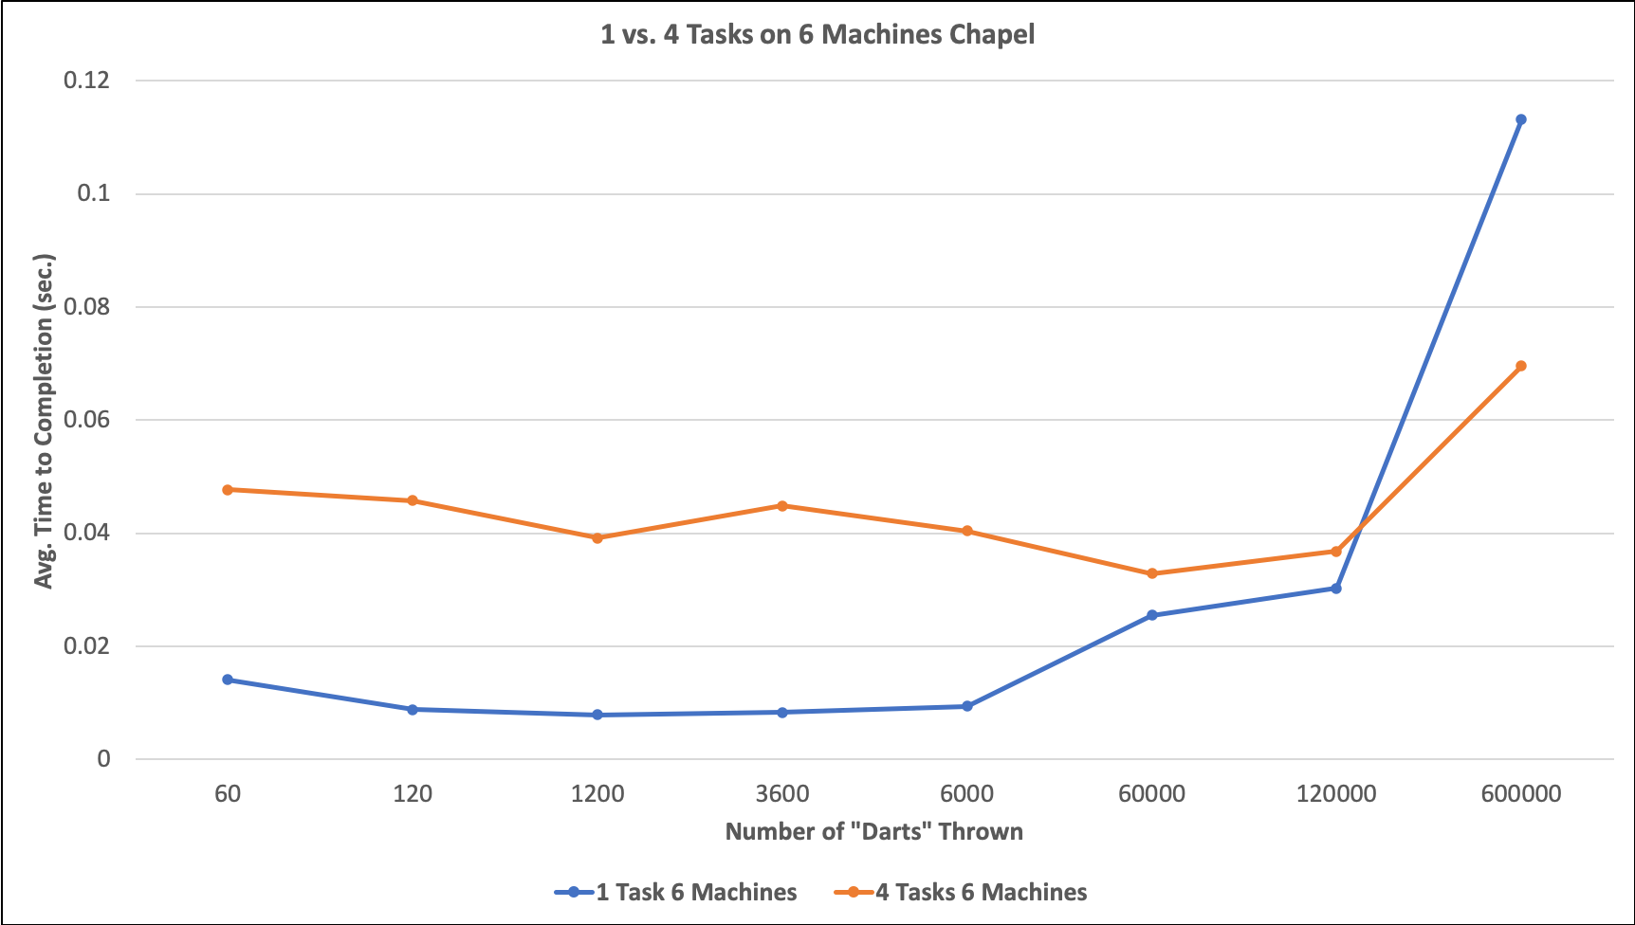
Results
Notes:
This next graph is a great representation of overhead that I mentioned before. This test was done only in Chapel and consisted of running a single core on 6 machines against 4 cores on 6 machines so a total of 6 cores versus 24 cores. We see that with very few operations having lots of cores and thus more workers is actually slower. This is because there is more communication needed and communicating is slow. However, as the work scales, more workers becomes beneficial and you get faster completion times. This balance of work to number of workers is exactly what the Kremer Herman method I reviewed in my lit review was trying to address by ”right-sizing” an application so it used the optimal number of workers.

Slide 11
Analysis
Chapel significantly slower than MPI
Chapel much more accessible
Less programming experience needed
Chapel easier to scale within code
Potentially use for specific instances
MPI as “industry standard” [4] for most applications
Notes:
From this experiment it’s clear that Chapel is much slower than MPI. However, Chapel is much more accessible and requires less programming experience. Chapel also makes it much easier to scale up the number tasks that are running and specifically where those tasks are going to be running. For example running 24 tasks across 6 machines with 4 cores is easier in Chapel than MPI.
There are some potential uses that I can see with Chapel, such as a researcher with very little programming experience that wants to run something in parallel will find it much more approachable and easier to learn. Or if the data set being used is relatively small. It could also be used as an effective language in academia to learn the concepts behind parallel computing. However, MPI is the industry standard for a reason and for any medium to large scale applications its execution time is too good and is not worth the trade off for a bit more accessibility.

Slide 12
Citations
[1] Nathaniel Kremer Herman, Benjamin Tovar and Douglas Thain (Nov. 2018). “A Lightweight Model for Right-Sizing Master-Worker Applications”. In: SC18.
[2] Estimating Pi Using the Monte Carlo Method. https://academo.org/demos/estimating- pi-monte-carlo/
[3] Sonsalla, Hannah (Apr. 2020). Monte Carlo Estimate Pi. online at selkie-macalester.org. URL: http://selkie-macalester.org/csinparallel/modules/MPIProgramming/build/ html/calculatePi/Pi.html.
[4] Barney, Blaise (Apr. 2020). Message Passing Interface (MPI). Livermore national lab. URL: https://computing.llnl.gov/tutorials/mpi/.

